Slide 1
CleanML: A Study for Evaluating the Impact of
Data Cleaning on ML Classification Tasks
DSCI560
Instructor：Young Cho, Ph.D.
Yifan Yang
8386626867

Slide 2
I. INTRODUCTION
Highlights from what I read：
1. ML community has been focusing on understanding the
impact of noises on ML models without actually performing
data cleaning-- the ML community has mostly been focusing on
designing ML algorithms that are robust to noises of certain
distributions
2.DB community has been mostly focusing on understanding
the fundamental process of data cleaning
the paper goal is to (1) conduct a
first systematic empirical study on the impact of data cleaning
on downstream ML classification models, for different error
types, cleaning methods, and ML models; (2) given our
empirical findings, provide a starting point for future research
to advance the field of cleaning for ML.
SECTION TITLE | 2
SECTION TITLE | 2

Slide 3
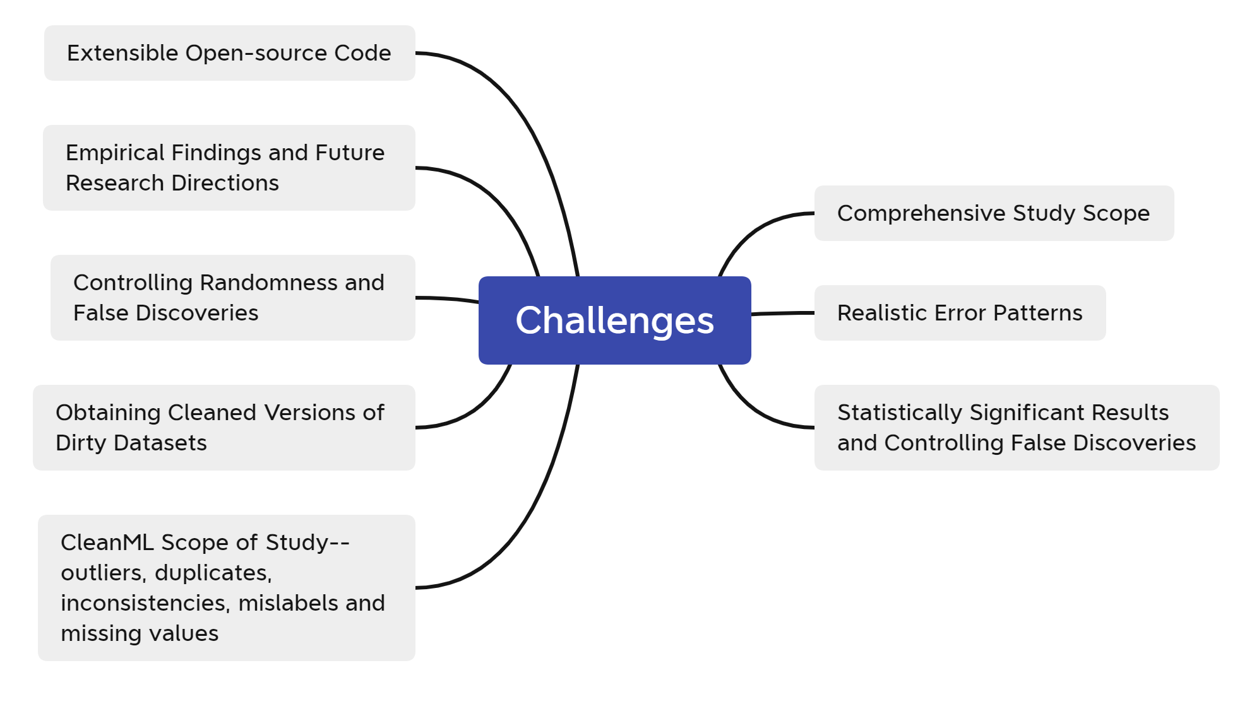

Slide 4
II. RELATED WORK
Highlights from what I read：
1. Recent research shows that even when combined with current error detection techniques, many errors in real-world data sets may still be missed
This illustrates the need for this work to incorporate errors in the data set
2. The database community began to research analysis-driven cleanup methods
However, there are still problems. Some analysis-driven examples are given to illustrate the current progress and potential problems.
3. CleanML considers five error types and seven ML models.
The specific contributions of this article are the above

Slide 5
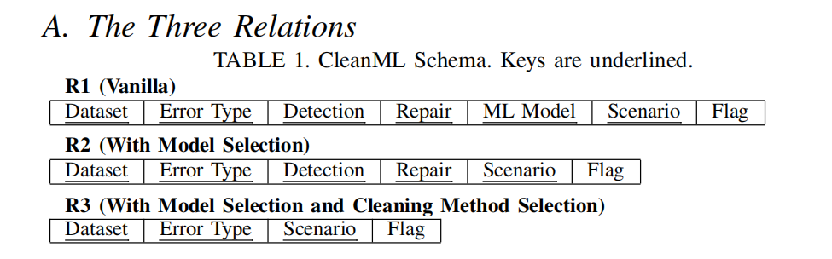
III. CLEANML DATABASE SCHEMA
The CleanML relational schema consists of three relationships, and the primary keys of all three relationships are underlined in the figure. This paper first introduces properties and then highlights the differences between these three relationships.
R1 is the vanilla version of our CleanML relations
Compared with R1, R2 eliminates the ML model attribute.
Compared with R2, R3 further eliminates the cleaning method (detection and repair) attributes.

Slide 6
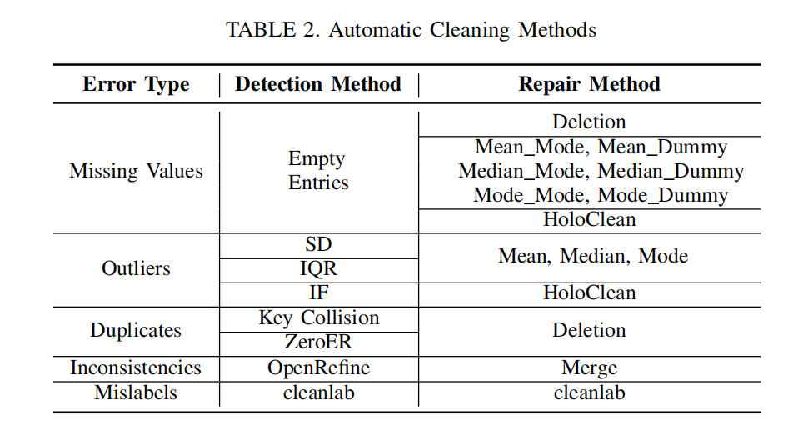
III. CLEANML DATABASE SCHEMA
In this section, the paper summarizes five common error types in real-world data sets, including missing values, outliers, duplicate values, consistency, and wrong labels. For each error type, various commonly used automated cleaning method practices as well as state-of-the-art cleaning methods are considered.
There are many methods introduced here, and I think one of the interesting methods is the interpolation method. Unsupervised ER (ZeroER),The state-of-the-art unsupervised method, called ZeroER,,achieves comparable performance to supervised methods, but,requires zero-labeled examples. And it's important to cleanlab to automatically clean error labels before running ML models, since it is model agnostic and can be easily configured for any Downstream model.

Slide 7
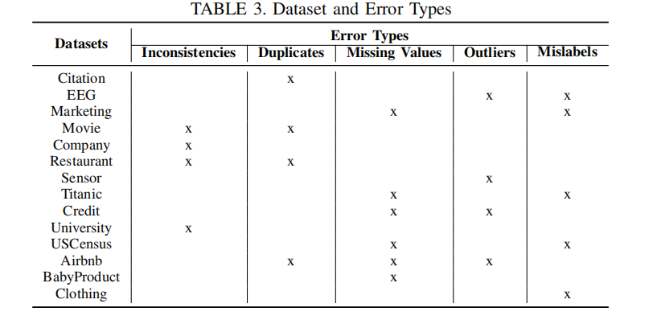
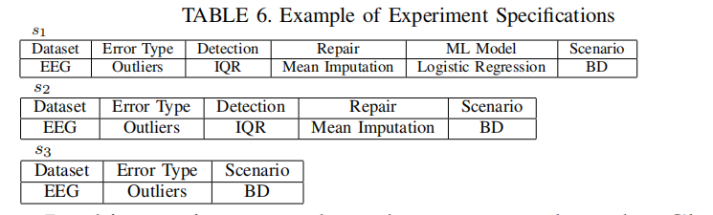
Experiments were conducted on 14 real-world data, followed by a classification task for structured data sets, using a variety of machine learning algorithms, including logistic regression, k-nearest neighbors (KNN), decision trees, random forests, and AdaBoost. , Naive Bayes and XGBoost are used to conduct experiments on the machine and scikit-learn is used to train the model.
The article also describes a scenario where data cleaning can be applied to the model development phase of training data, and can also be applied to the phase of model deployment and test data. The logic of this section is to evaluate the impact of cleaning on the ML model. So two models need to be trained, one trained on the original dirty training set and one trained on the cleaned version. Then conduct a comparison test to compare their differences between the four cases ABCD.

Slide 8
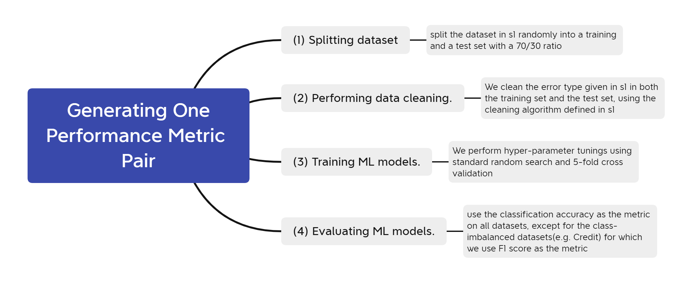
IV. CLEANML DATABASE INSTANCE
A. Generating One Performance Metric Pair

Slide 9
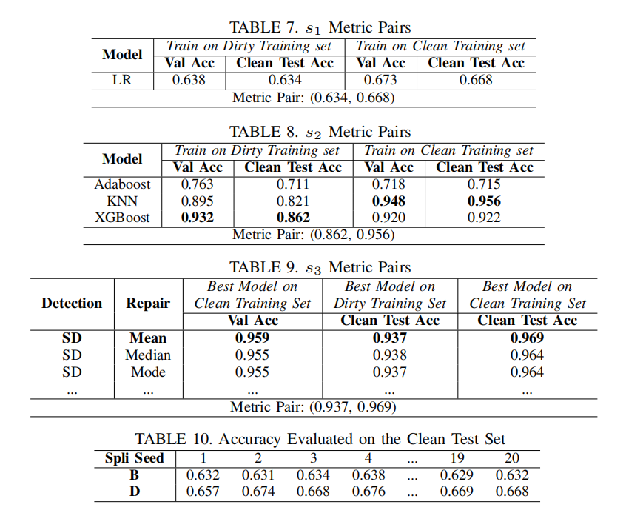
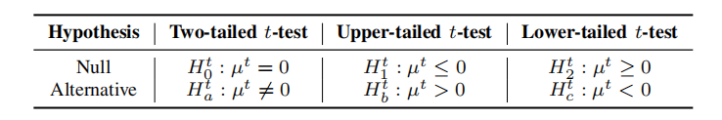
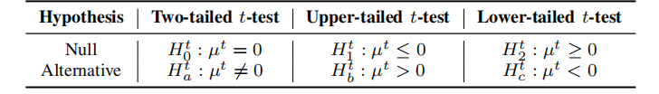

B. Handling Randomness
This section focuses on dealing with ML stochasticity, running the same procedure 20 times, each time with different training/testing. Follow strict statistical significance based on 20 indicators to determine the sign of the test procedure for pairs.

Slide 10
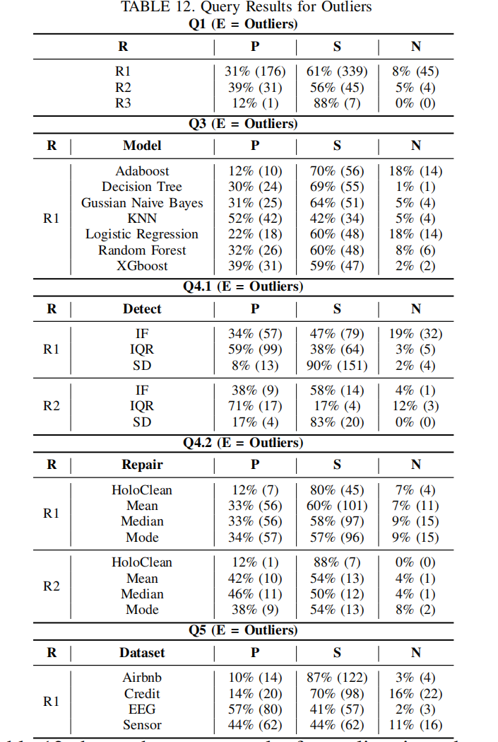
Controlling False Discoveries
Control strategies for false discovery rates caused by multiple hypothesis testing problems often adjust the significance level in some cases.
V. ANALYZING CLEANML DATABASE
Varying Granularity of Analysis. The impact of cleaning on ML depends on a variety of factors, warranting varying granularities of analysis.
Compare R1, R2, and R3. We also investigate the difference of results between the same query template issued against different relations.

Slide 11
(Q1): As we can see in the results of Q1, missing values are cleaned by imputation
Mainly to improve performance or achieve similar performance as deleting records with missing values. However, there are
There are still quite a few "N" flags in the results for R1 and R2, suggesting that interpolation may be worse than deletion.
(Q2): As stated in Section III-E, we only consider missing scene BD values, so Q2 does not apply.
(Q3): All models share similar results to what we observed in Q1; the results table is
Omitted here.
(Q4): Since there is only one detection method for missing values, Q4.1 does not apply. From the results Q4.2 Regarding R1 and R2 (Q4.2 does not apply to R3), we can see that there is no significant difference between the effects of different imputation methods.
(Q5): We show results for Q5 published only for R1 because the results reveal similar findings for Q5 published for R2 and R3. As we can see, the impact of data cleaning varies greatly across different datasets.

Slide 12
V. ANALYZING CLEANML DATABASE
A. Strategy for Result Analysis
Varying Granularity of Analysis.
Compare R1, R2, and R3.
Summary of Observations for Missing Values.
(1) Cleaning missing values by imputation is more likely to improve ML or
achieve similar performance compared with deletion;
(2) with model and imputation method selection, we are more likely to observe positive impacts and less likely to observe negative impacts;
(3) impacts vary largely across different datasets and advanced cleaning methods such as HoloClean [44] is not noticeably better than simple imputation methods.

Slide 13
Summary of Observations for Outliers.
(1) Cleaning outliers is more likely to have insignificant impact on model performance, at least for the set of outlier cleaning algorithms we considered; (2) with model selection and cleaning algorithm selection, the probability of having negative impacts can begreatly reduced;
(3) the impact of cleaning varies vastlyacross datasets;
(4) since outliers are harder to clean, different detection methods have major differences in observed impact.
Summary of Observations for Mislabels:
(1) Cleaning mislabels is likely to have positive or insignificant impacts on ML;
(2) With model selection, it is more likely to have positive impacts.
(3) boosting based ML models are most reactive to mislabels.
(4) the impact varies significantly across datasets.

Slide 14
Summary of Observations for Inconsistencies:
(1) Cleaning inconsistencies is more likely to have insignificant impact and
unlikely to have negative impact on ML;
(2) the impact varies significantly across datasets.
Summary of Observations for Duplicates:
(1) Cleaning duplicates is more likely to have insignificant or negative
impacts than positive impacts;
(2) the impact on cleaning duplicates varies vastly across detection methods and datasets.
VI. OVERALL OBSERVATIONS FOR SINGLE ERROR TYPES
Strong Dependency on Dataset
Consistent Impact from Cleaning w.r.t. Model and Scenario.
Strong Dependency on Cleaning Algorithms.

Slide 15
VII. MIXED ERRORS, ROBUSTML AND HUMAN CLEANING
Cleaning all error types in a data set is not always better than cleaning a single error type. In contrast, this does not always produce better models without cleaning and is dataset dependent. The chance of clearing multiple bugs that negatively impact the category is also low. Cleaning up duplicates can have negative consequences. Beyond any single error type, additionally cleaning up missing values or outliers may have a positive impact on results, and in all cases has no negative impact.

Slide 16
.
Data cleaning can lead to better final models with strong machine learning capabilities. Advantages of Data Cleaning over Robust ML Broadening. Data cleaning can be performed for any error type and the cleaned data set can be used to train any final model, while robust machine learning algorithms are often specifically designed for error types and specific model types. The duplicates are the only error type that deep learning outperforms overall is cleaning, which can be explained by our previous finding that cleaning duplicates can harm machine learning models.
Humans manually fill in missing values and correct incorrect labels, and the resulting cleaning by humans outperforms the best automated cleaning methods. We observed that the results of rule-based cleaning were not significantly different from using automated cleaning methods.

Slide 17
VIII. FUTURE RESEARCH
Future research could investigate how various errors affect other ML tasks, such as regression tasks and unsupervised clustering. More realistic data set ground truth could enhance research on human cleaning. For machine learning, we have a clearer goal, which is to improve the performance of downstream machine learning models. Therefore, designing new cleaning algorithms to maximize machine learning model performance is a promising direction.
The main challenge in this direction is to avoid training machine learning to model multiple times to select the best candidate. When multiple error types occur simultaneously, designing automatic cleaning becomes more challenging as the space of cleaning methods becomes increasingly more challenging, and non-trivial interactions/dependencies may exist. Our current study has not considered differences between different error types or cleaning methods.
Cleaning solutions that involve human cleaners can be designed. Our research shows that human cleaning, especially when directly correcting data errors, can produce better machine learning models compared to automated cleaning.

Slide 18
Q1: Large models are trained on massive data sets. How scalable are existing data cleaning methods for such large-scale data? Can they effectively handle the large amounts and variety of data required by these models?
Q2: What are the advantages and disadvantages of manually cleaning datasets by humans versus using automated algorithms to clean datasets?

